Slide 1

Credit Card - Fraud Prediction
Vinay Nagaraj & Vikas Ranjan
DSC630, Spring 2021
Bellevue University, NE

Slide 2
Problem Statement
Credit card fraud was ranked number one type of identity theft fraud. Each year financial institutions lose a significant amount of money as a result of credit card fraud.
Due to increase in fraud rates, researchers have started using different machine learning methods to detect and analyze frauds in online transactions.
This project intends to create a model for credit card fraud detection using past credit card transactions with the knowledge of the ones that turned out to be a fraud.

Slide 3
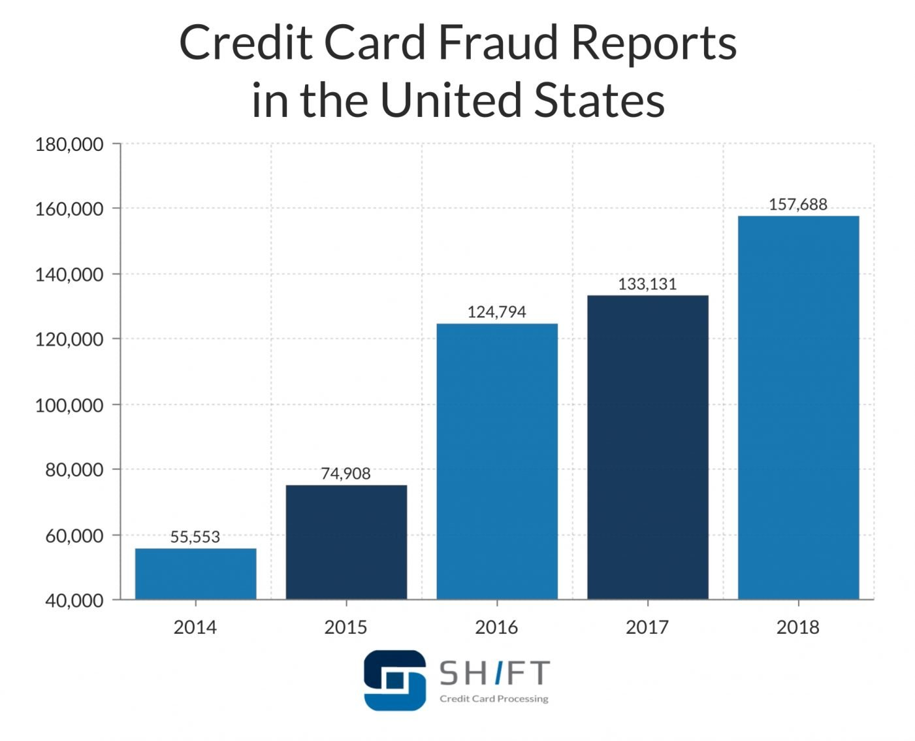
Credit Card Fraud Stats
In year 2018, a total of $24.26 Billion was lost due to payment card fraud across the globe.
Credit card companies have developed extremely sophisticated tools for detecting fraud.

Slide 4
Process Overview
Preliminary analysis on data
Data preparation and cleaning for any missing values.
Perform Exploratory Data Analysis
Train and test models
Model evaluation and tuning

Slide 5
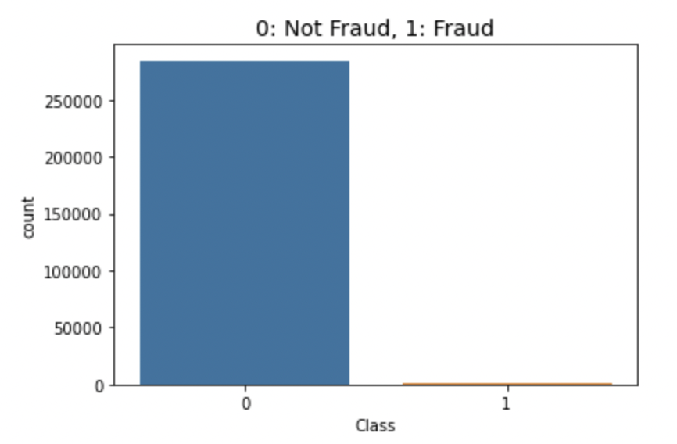
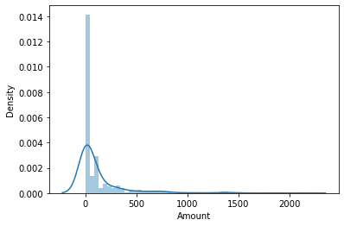
Dataset Overview
Dataset contains 2 days of Credit card transactions from Sept ’13 by European cardholders.
Out of 284,807 transactions, 492 are fraud.
Most of the fraudulent transactions are of small amounts.

Slide 6
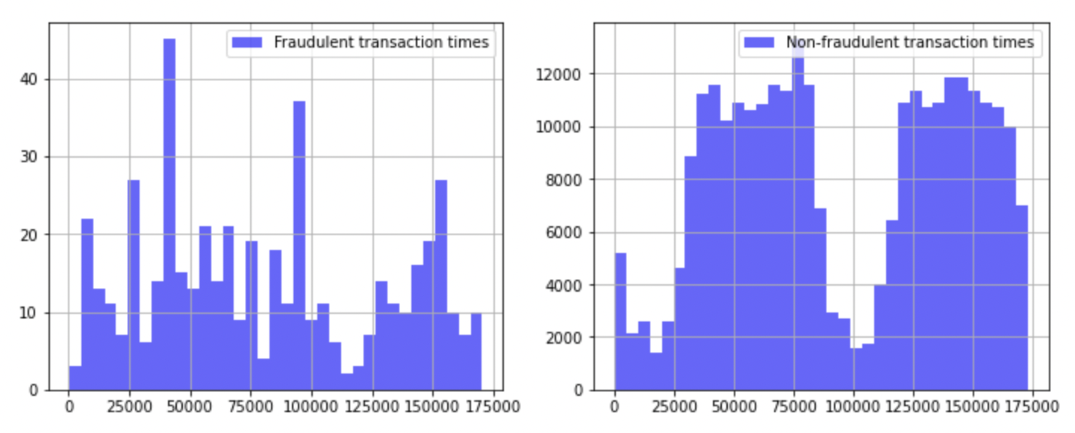
Transaction Times
Fraudulent transactions are spread throughout the day.
This makes transaction time not one of the important features we can use for our model.

Slide 7
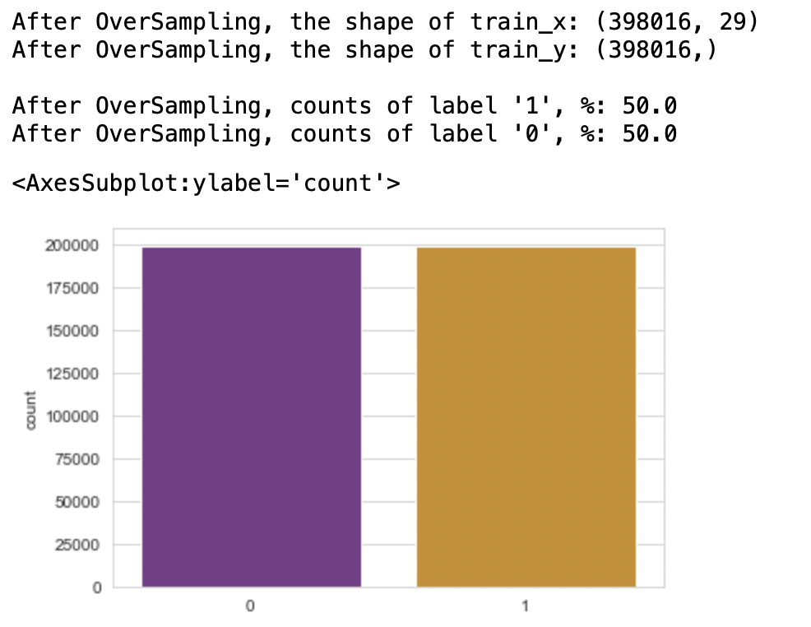
SMOTE – Oversampling
Our dataset is highly imbalanced as most of the transactions are non-fraudulent.
We are implementing oversampling technique called SMOTE to handle our imbalanced dataset.

Slide 8
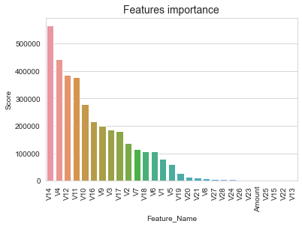
Feature Importance
Target variable – “Class” which determines if a transaction is fraudulent or not.
SelectKBest technique used to identify most relevant features.

Slide 9
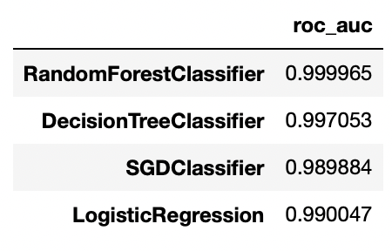
Classification Models
Aggregate measure of performance across the 4 classification models is shown here.
We choose to use RandomForest and Logistic Regression model due to their accuracy scores.

Slide 10
Random Forest Model
Random Forest Model provides us a high true prediction values for our dataset.
98.528% of the time, our model will correctly predict if the transaction was fraudulent or not.

Slide 11
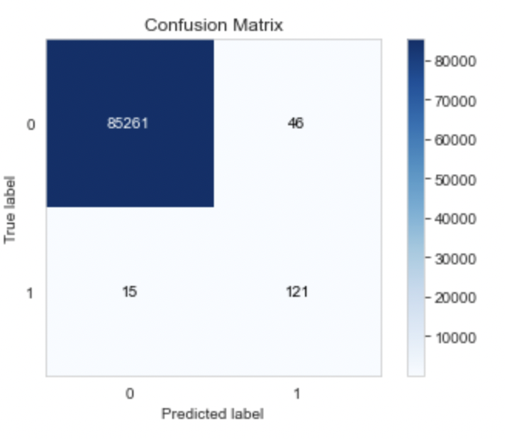
Random Forest Model – Confusion Matrix
85261 transactions are true negative
121 transactions are true positive.
15 transactions are false negative.
46 transactions are false positives.

Slide 12
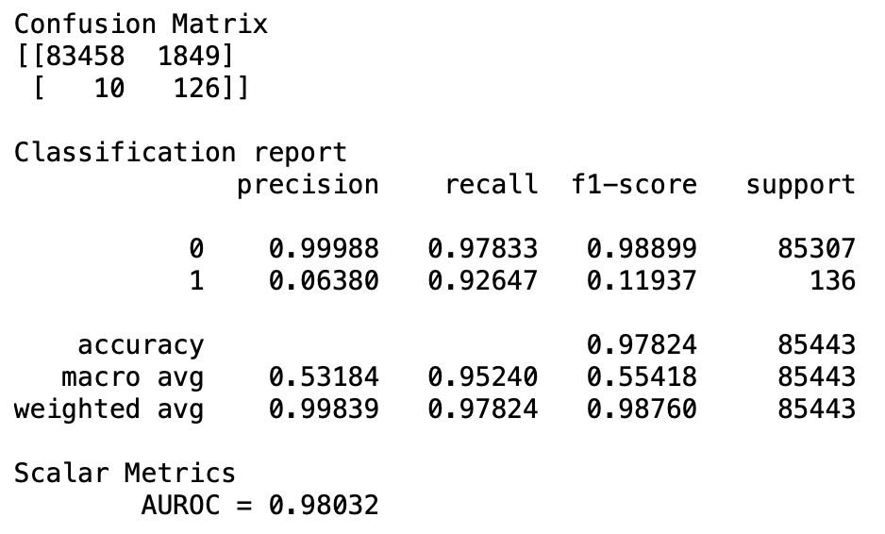
Logistic Regression Model
This model has an AUROC of 0.98032 which means that the model has very good discriminatory ability.
98.032% of the time, our model will correctly predict if the transaction was fraudulent or not.

Slide 13
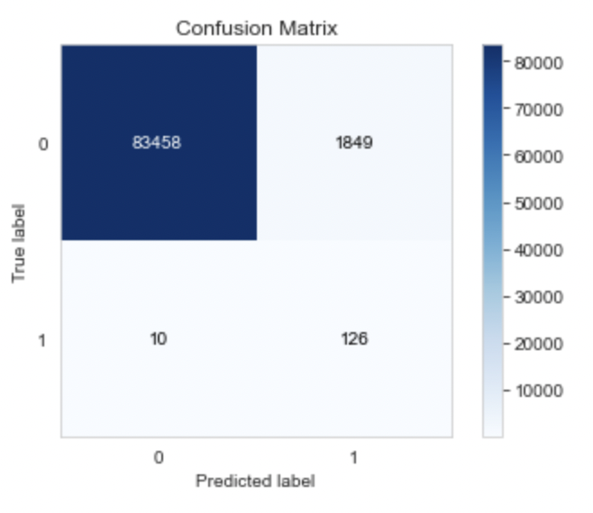
Logistic Regression Model – Confusion Matrix
83458 transactions are true negative
126 transactions are true positive.
10 transactions are false negative.
1849 transactions are false positives.

Slide 14
Conclusion
Transaction time does not have any influence on prediction of fraudulent transaction.
SMOTE oversampling technique helped overcome the Imbalanced datasets challenge.
Best suited classification model for our dataset would be Random forest model.

Slide 15
References
ULB, M. (2018, March 23). Credit card fraud detection. Retrieved March 27, 2021, from https://www.kaggle.com/mlg-ulb/creditcardfraud
Credit card Fraud Statistics. (2021, January 04). Retrieved March 27, 2021, from https://shiftprocessing.com/credit-card-fraud-statistics/
Siegel, E. (2016). Predictive analytics: The power to predict who will click, buy, lie, or die. Hoboken, NJ: Wiley.

